Slide 1
Super MirAo

Slide 2
160041024 Abir Azad 160041063 Afifa Hossain 160041012 Md. Abeed Hanif Aurko 160041067 Eksan Ahmed Emon 160041026 Md. Rabiul Alam Abir 160041017 Md. Abu Sadeed
Created By

Slide 3

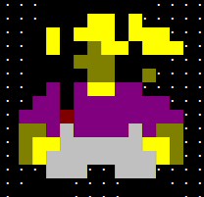
A 2-D tile Based Game
Made from the scratch
Using Windows Command Prompt
Based on Console Game Engine
Get the points,
lead the sheet

Slide 4
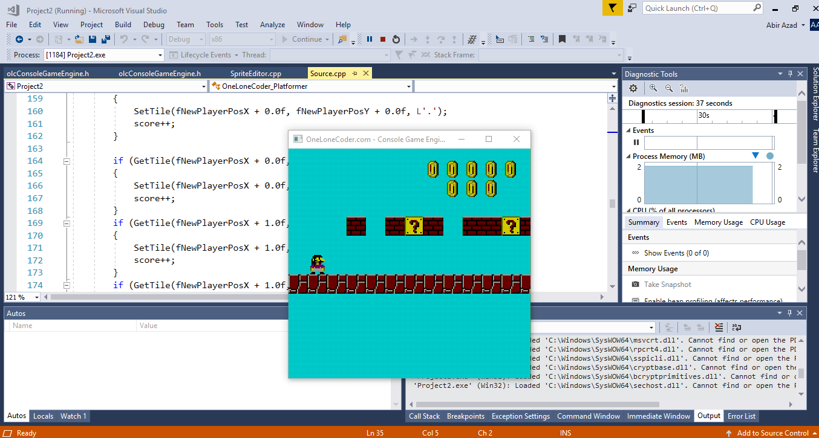

Slide 5
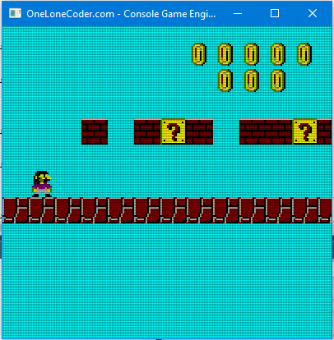
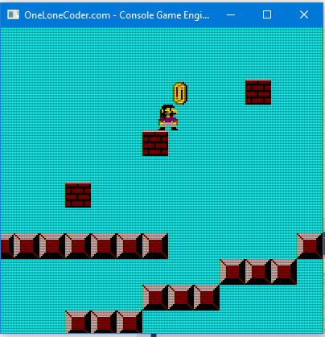
Game Screen

Slide 6
Main Motto
Roam around the map
Collect as much collectibles as possible
Collect as soon as possible

Slide 7
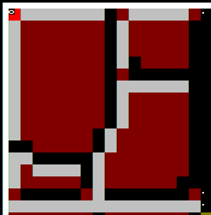

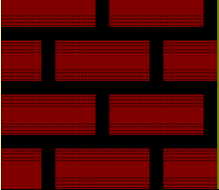
Types of Tiles
Street blocks. Cannot be broken.
Stone blocks. Cannot be broken.
Brick blocks. Can be broken.
Gift blocks. Can be broken and get collectibles.

Slide 8
Creation From the Basics…

Slide 9
Collisions
All collisions are resolved using floating point truncation
Collisions ensure that the player doesn’t cross or go through a solid wall.
Gravity
Continuously adding a value towards Negative of Y as
(20.0f * Elapsed Time)
Ensures that the player come back to the surface from the air.

Slide 10
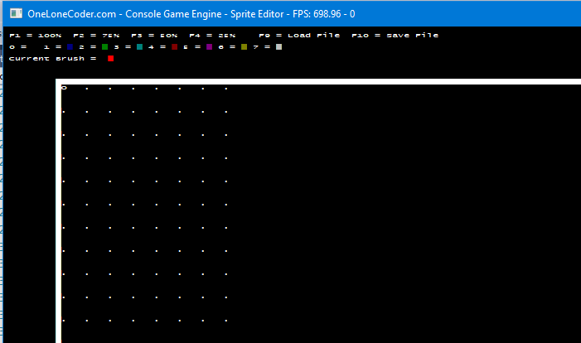
ONE LONE CODER GAME ENGINE
The Base - olcConsoleGameEngine.h
It’s a Console Game Engine coded in C++
For adding Graphics – SpriteEditor.cpp
Also coded in C++
For creating all icons and
using them in the game

Slide 11
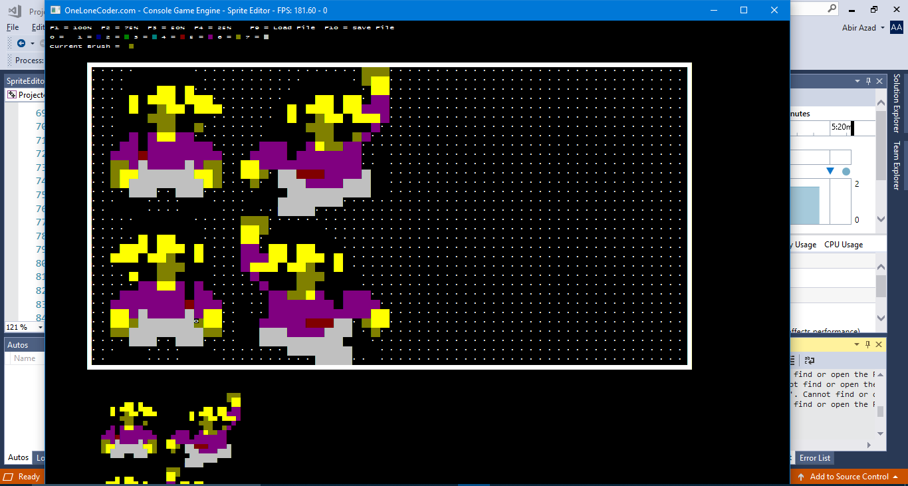
Creating Our Character -The SUPER MIRAO

Slide 12
Creating OTHER Graphics SpRites

Slide 13
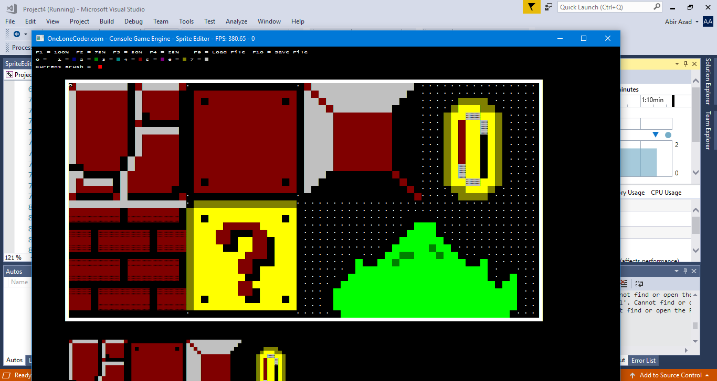

Slide 14
Why CreaTE Console Game?
This is where everything starts
Have to control from the basics.
More and detailed control over the machine
Better visualization of how computer handles the game
……………………………………….
Or maybe just to get a little bit nostalgic…

Slide 15
DISADVANTAGES
Too much details, sometimes boring
Graphics usually very primitive
Hard to debug
Program crushes too often while trying to build
Need a lot of effort to make it efficient.

Slide 16
Game is still on Update….

Slide 17
Will be Added with time
Enemy – colliding will cause game over.
Guns – for killing the enemies.
Water block – can not be walked over. Walking over will cause game over.
**New Levels**

Slide 18
Thank YOu

